Slide 1


Slide 2


Slide 3
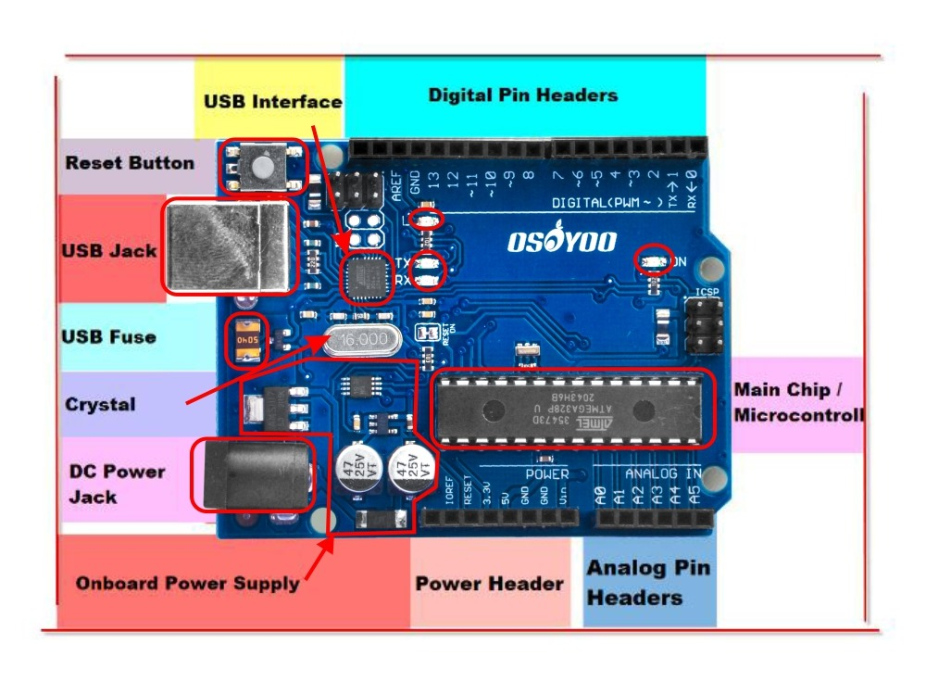

Slide 4

Arduino Definition Arduino is a programmable electronic circuit board, often used for electronics projects and robotics. The microcontroller is the brain of the Arduino, enabling it to execute programmed instructions.
Key Features
- 14 digital pins
Analog pins
- Source of voltage and current

Slide 5

Main Chip / Microcontroller: The central processing unit of the Arduino, responsible for executing programs and controlling the connected components.
USB Interface: A port used to connect the Arduino to a computer for programming and communication.
Digital Pin Headers: A row of pins used for digital input/output operations, where you can connect sensors, LEDs, and other digital devices.
Analog Pin Headers: A row of pins used for reading analog signals from sensors like temperature sensors, light sensors, etc.
Power Header: Pins used to supply power to the Arduino and connected components.

Slide 6
7.DC Power Jack: The port for connecting an external power supply, usually a battery or a power adapter.
8.USB Jack: Used for programming and power supply via USB cable.
9.Reset Button: A button used to restart the program running on the Arduino.

Slide 7
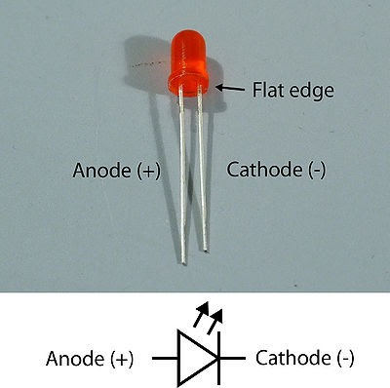
On an LED (light-emitting diode), the positive terminal is the anode, and the negative terminal is the cathode. Because an LED is a diode, electrical current can only flow in one direction. Connecting it backward will prevent it from lighting up and could potentially damage the component.

Slide 8
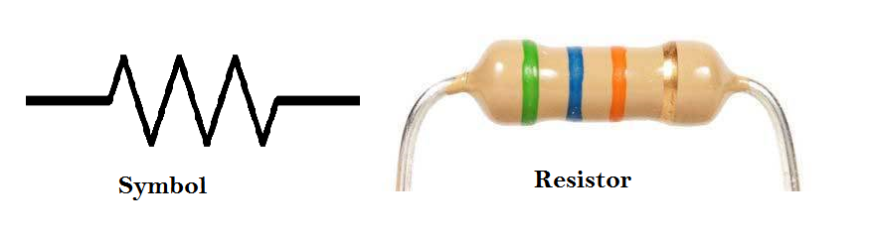
A
resistor is a passive two-terminal electrical component that opposes the flow of electric current in a circuit. This opposition, or resistance, is measured in ohms and is used to control current, divide voltage, and protect components

Slide 9
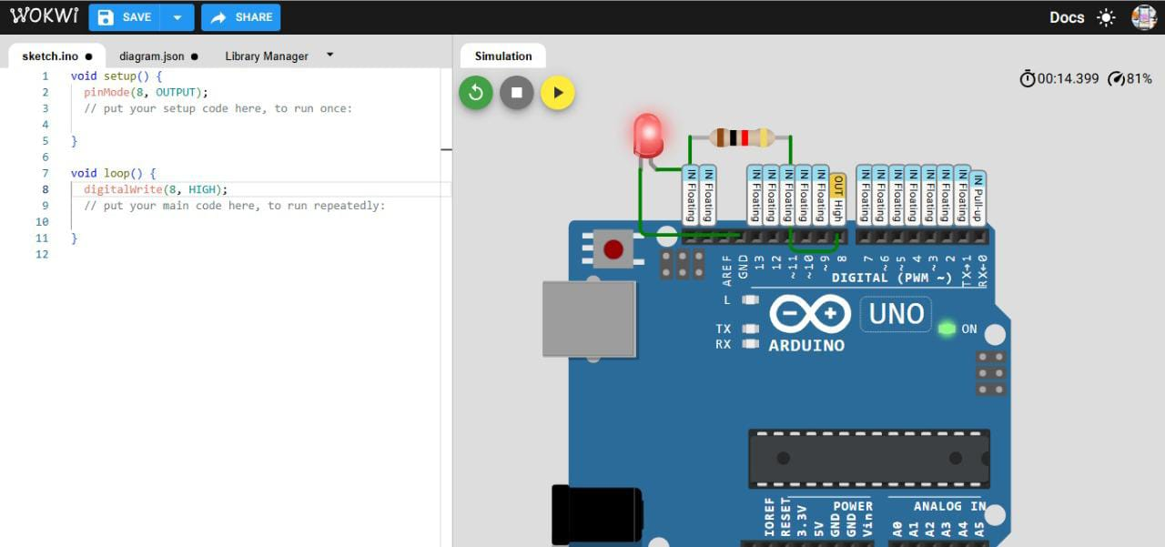

Slide 10
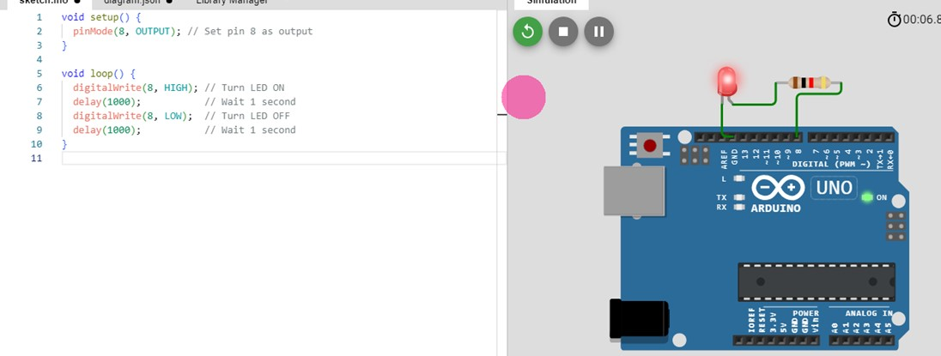

Slide 11


